Slide 1


5G IMPACT ANALYSIS: WAVECON TELECOM INSIGHTS
Presented By : Kavya Rana

Slide 2

AGENDA
Introduction
Revenue Performance in the Wake of 5G Innovation
Impact of 5G Launch on Revenue
Underperforming KPIs Post-5G Launch
Plans Performing Well After 5G Launch
Plans Not Performing Well After 5G Launch
Analysis of Plans Affected by the 5G Launch
Discontinued Plans Post-5G Launch and Reasons
Recommendations

Slide 3
INTRODUCTION
Wavecon Telecom has recently launched its 5G services, marking a major shift in its product portfolio and customer engagement.
This analysis provides insights into key metrics such as revenue, KPIs, and plan performance, helping the company assess areas of success and concern.

Slide 4




Revenue Performance in the Wake of 5G Innovation
₹ 31.9 bn
Total Revenue
₹ 16.0 bn
Before 5G
-0.50%
Revenue Change
₹ 15.9 bn
After 5G
Overall revenue decreased slightly by 0.5%, from ₹16 billion to ₹15.9 billion.

Slide 5
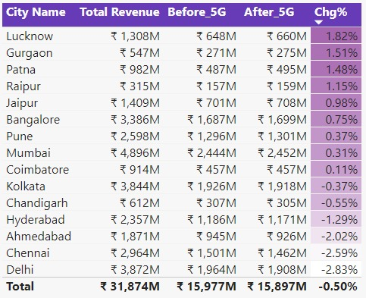
Impact of 5G Launch on Revenue
Insights
Lucknow's Surge: Following the 5G launch, Lucknow outperformed expectations with a revenue boost of 1.82%, showcasing its potential as a market leader.
Delhi's Decline: Conversely, Delhi faced challenges post-5G, witnessing a revenue dip of -2.83%, highlighting areas for improvement and strategic intervention.

Slide 6
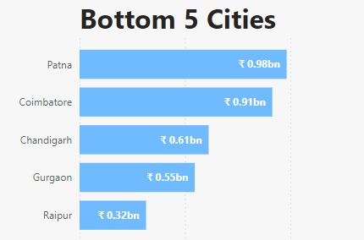
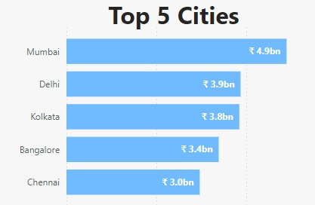
Impact of the 5G Launch on Revenue
Top Performing Cities: Mumbai, Delhi, and Bangalore saw significant revenue growth.
Underperforming Cities: Patna and Coimbatore reported declining revenues, reflecting weaker adoption.

Slide 7



Underperforming KPIs Post-5G Launch
₹ 200.7
161.7 M
12.6 M
Average Revenue Per User
Total Active Users (TAU)
Total Unsubscribed Users(TUSU)

Slide 8
Underperforming KPIs Post-5G Launch on TAU
TAU Before 5G launch
84.4M
TAU After 5G launch
77.4M
Despite the launch of 5G, the total number of active users declined by 8.28%.
TAU: Total Active Users

Slide 9
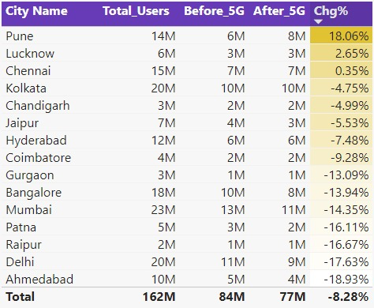
Underperforming KPIs Post-5G Launch on TAU
Pune recorded the highest increase in active users, growing by 18.06%.
Ahmedabad experienced the most significant decline in active users, with a drop of -18.93%.

Slide 10
Underperforming KPIs Post-5G Launch on TUSU
TUSU Before 5G launch
5.6M
TUSU After 5G launch
7.0M
Despite the launch of 5G, the total number of unsubscribed users increased by 23.5%.
TUSU: Total unsubscribed users

Slide 11
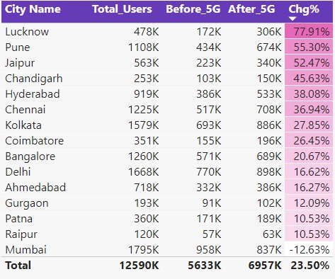
Underperforming KPIs Post-5G Launch on TUSU
Lucknow recorded the largest increase in unsubscribed users, rising by 77.91%.
In contrast, Mumbai experienced a decline in unsubscribed users, with a change of -12.63%.

Slide 12

Plans Performing Well After 5G Launch
Plan P1:
Smart Recharge
Pack 2 GB/Day Combo
For 3 months
Before 5G launch
₹ 1.8bn
After 5G launch
₹ 2.4bn
Plan P11:
Ultra Fast Mega
Pack 3GB/day Combo
For 80 days
Before 5G launch
N/A
+33.33%
After 5G launch
₹ 1.9bn
Plan P12:
Ultra Duo Data
Pack 1.8GB/day Combo
For 55 days
Before 5G launch
N/A
After 5G launch
₹ 1.2bn

Slide 13
Plans Not Performing Well After 5G Launch
Plan P4:
Mini Data Saver Pack 500 MB/Day,
Valid For 20 days
Before 5G launch
₹ 1.1bn
-20.11%
After 5G launch
₹ 0.9bn
Plan P5:
Rs.99 Full Talktime Combo Pack
Before 5G launch
₹ 1.0bn
-34.85%
After 5G launch
₹ 0.65bn
Plan P6:
Xtream Mobile Data Pack
15GB Data | 28 days
Before 5G launch
₹ 0.7bn
-34.00%
After 5G launch
₹ 0.5bn
Plan P7:
25 GB Combo 3G/4G data pack
Before 5G launch
₹ 0.6bn
-73.30%
After 5G launch
₹ 0.2bn

Slide 14
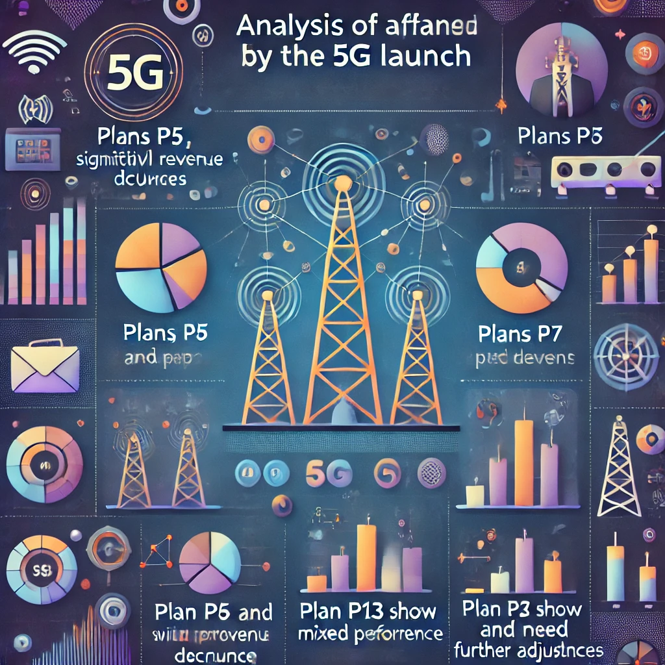
Plans Performance
Plans Performing Well After 5G Launch
Plan P1 showed significant revenue growth of 33.33%, becoming a top performer.
New Plans P11 and P12 generated substantial revenue post-launch, indicating strong market demand.
Plans Not Performing Well After 5G Launch
Plans P2 and P3 reported no change in revenue, maintaining their previous performance.
Plans P4, P5, P6, and P7 experienced substantial revenue declines post-5G launch.
Plans P8, P9, and P10 were discontinued following the 5G rollout.
Plan P13 generated some revenue but at a relatively low level.

Slide 15
Analysis of Plans Affected by the 5G Launch
Plans to Continue:
Plan P1: +33.33% revenue growth
Plan P11 (New): Strong performance post-launch
Plan P12 (New): Strong revenue generation
Plans to Discontinue:
Plan P5: -34.85% revenue decline
Plan P6: -34.00% revenue decline not meeting market needs
Plan P7: -73.30% revenue decline
Plans to Reevaluate:
Plan P4: -20.11% revenue decline, mixed performance
Plan P13 (New): Some revenue generated but requires further assessment

Slide 16
Discontinued Plans Post-5G Launch and Reasons
The plan's short validity and low revenue likely indicated weak user interest or poor alignment with market needs.
Plan P8:
Daily Saviour
1( GB/Day) validity: 1day
It was discontinued post-5G launch, potentially due to its insufficient data offering in a high-demand 5G environment.
Plan P9:
Combo TopUp
1495 Talktime and 300 MB data
Plan P10:
Big Combo
Pack (6 GB/Day) validity: 3 days
Similar to Plan P8, the plan's limited validity and specific usage patterns may have contributed to its lack of appeal, leading to discontinuation.

Slide 17
Recommendations
Strengthen 5G Capabilities: Enhance 5G network performance and introduce compatible devices and services to meet user expectations and drive adoption.
Review Pricing and Plans: Reassess pricing models to ensure market competitiveness, and design appealing 5G bundles that cater to customer needs.
Expand 5G Network Reach: Accelerate efforts to broaden 5G coverage and invest in infrastructure upgrades to capture a wider audience.
Enhance Customer Support: Improve customer service and technical assistance for swift issue resolution, boosting user satisfaction and loyalty.
Launch a Customer Loyalty Program: Develop a rewards program offering discounts, exclusive deals, and premium content to incentivize long-term customer retention and reduce the number of people leaving.

Slide 18
THANK YOU

